Slide 1
Dependency Injection
The Problem
A common pattern within web development - especially among beginners - is to pile a whole lot of code that does everything that a web page needs (data, emailing, error handling, logging, authentication etc) into one place.
In the Microsoft world, this practice has evolved from spaghetti code in a classic ASP code file, to the code behind file for a web form, and then to a controller in an MVC application.
Take a look at the following:

Slide 2
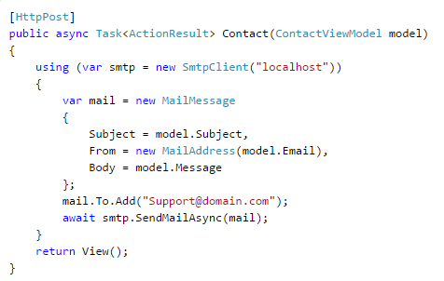

Slide 3
Dependencies
The main problem is that the controller class has a responsibility for something which is not part of its primary concern. The code that manages the emailing is a dependency of the controller class. This potentially introduces the following problems:
If you want to change your emailing system over to e.g. Exchange Web Services, you have to make changes to the controller class . This violates the Single Responsibility Principal. The controller class should only be responsible for martialling data for views. It should not be responsible for sending email.
If you have similar emailing functionality in multiple places in the application, you have to make the same change multiple times. The more places you have to make changes in, the more chance there is of you introducing other bugs to other parts of the application - or overlooking one or more areas where the change needs to be applied.
If you want to unit test your controller's Contact method (to ensure it returns the correct View, for example), you will not be able to do so without generating an email. This will require communication with outside processes, which will slow tests down.

Slide 4
Good design practice recommends that you create specific components or services to cover discrete and separate pieces of functionality (or separate your concerns), and then call upon these services where needed.
In this example, the code concerned with mailing should be separated out into its own component which will expose a public method that can be called from within the controller.
This is how the code might be refactored to create a separate class called EmailSender, which is responsible for the actual sending of the email:

Slide 5
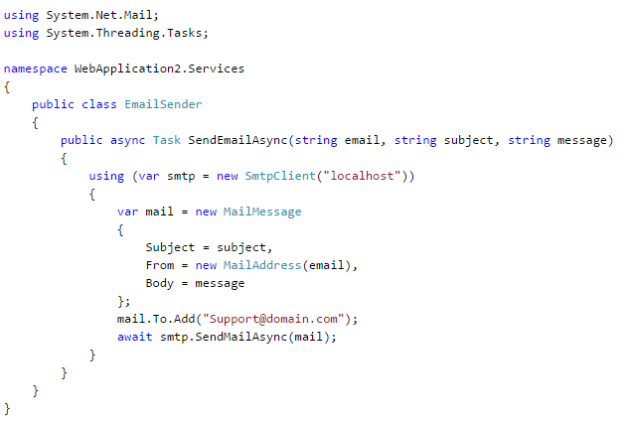

Slide 6
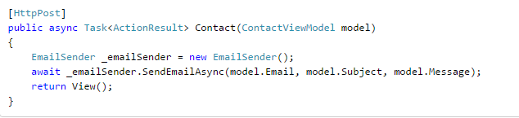
And this is how the EmailSender component is consumed within the controller action:
This is better, because now the controller has no knowledge of how emails are sent.

Slide 7
But there is still a problem.
The controller is still dependent on (tightly coupled with) a specific (or concrete) type of email component.
When you test the controller action, an email will still get sent. You could makes changes to the code to replace the EmailSender class with a MockEmailSender class that doesn't actually do anything whenever you want to run your tests.
However, having to do that in multiple places, and for all the other services that rely on outside processes (logging, data access etc.) every time you wanted to run your tests, and then reversing all the changes afterwards is not a practical solution.

Slide 8
Dependency Injection
Dependency injection (DI) is a design pattern. The problem it attempts to address is the one outlined above, where a class is tightly coupled to a specific implementation of a service. DI offers one way to loosen that coupling by having the service injected into the dependent class. You can do this in a number of ways. You can inject the service into the class's constructor or into one of its properties using the setter. Or, rather than inject a specific type of the service (EmailSender or MockEmailSender or ExchangeEmailSender) you inject an abstraction that represents the service. The abstraction is defined in an interface.

Slide 9
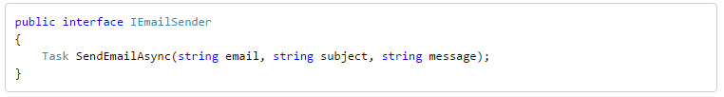
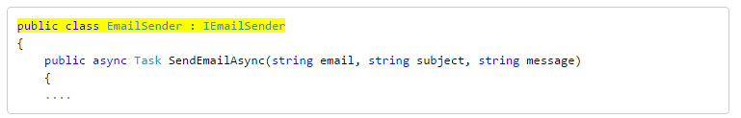

Slide 10
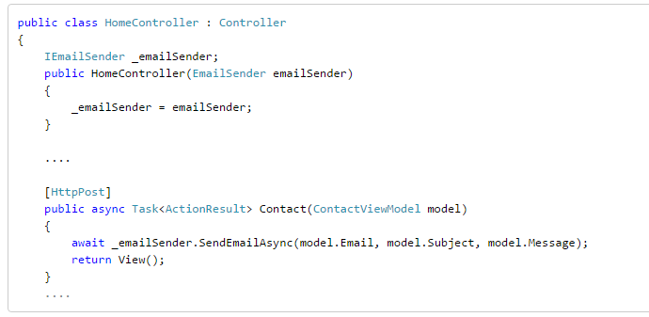
The next iteration of the controller sees the EmailSender class injected via the class constructor.

Slide 11
Still a lot more can be done in this but for now
I want you to try dependency injection in MVC
With code

